Slide 1
Rain Barrel
Learning for Water
wehelptwo.com

Slide 2
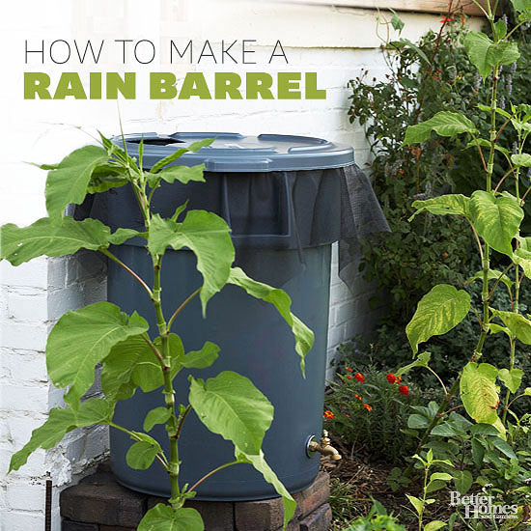
Why make a rain barrel
Using a rain barrel can save you a significant amount of money in a season. For each inch of rain that falls on 500 square feet of roof, you can collect 300 gallons of water.
In most areas of North America, that means you can collect more than a thousand gallons of water a year to use in your containers, houseplants, garden, or even your lawn. However, rain barrels are illegal in some areas -- be sure to check your local regulations before starting.
Project Time: Approximately 2 hours

Slide 3
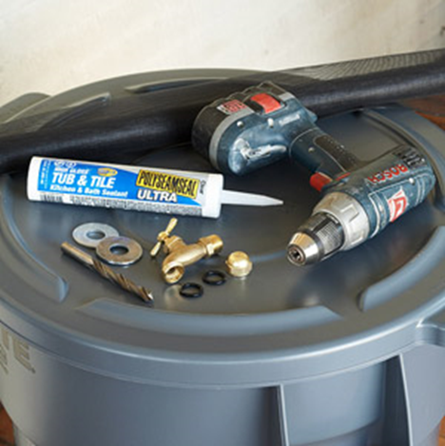
Step 1: Gather Your Materials
It's probably easier than you think to make a rain barrel.
Here's what we used:
-- 1 large plastic garbage can (the larger it is, the more water you can collect)
-- 1 tube of watertight sealant or roll of Teflon tape for plumbing
-- 2 rubber washers
-- 2 metal washers
-- 1 hose clamp
-- 1 spigot
-- A drill
-- Landscaping fabric

Slide 4
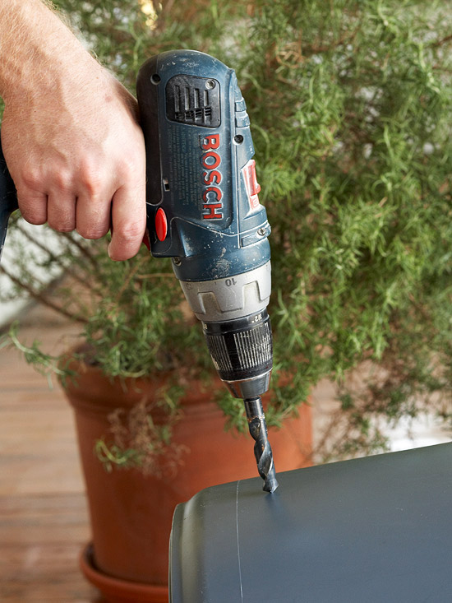
Step 2: Drill a Hole
You don't need a rain barrel kit to conserve water! Start by using your drill to create a hole near the bottom of your barrel. This is where you'll insert your spigot. Use a drill bit that's a little smaller than or the same size as the spigot.
Rain Barrel Hint: Don't create a hole that's too low -- you'll want to leave space underneath to fill your watering can.

Slide 5
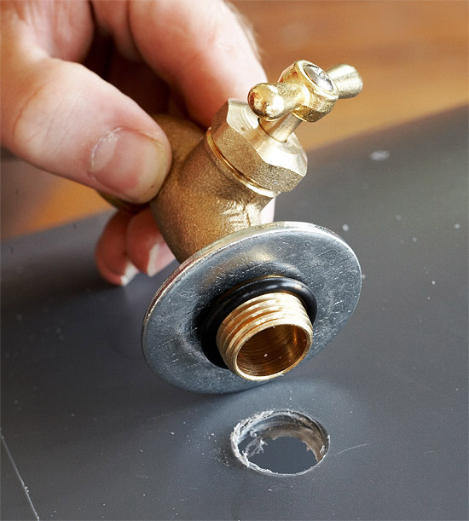
Step 3: Insert the spigot
Place a metal washer onto the threaded end of spigot, then put a snugly fitting rubber washer over the threads to help hold the washer in place and prevent leakage.

Slide 6
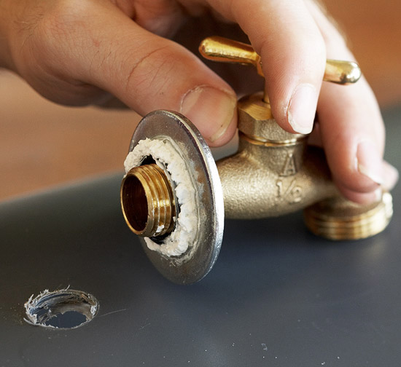
Step 4: seal it up
Next, apply a bead of waterproof sealant over your rubber washer and insert the spigot into the hole. Wait for the sealant to dry, then run a rubber washer, followed by a metal washer onto the threads of the spigot inside the barrel. Secure the spigot in place inside your barrel with the hose clamp. This is important because it will keep your spigot from coming loose from your barrel.
Rain Barrel Hint: You can also run watertight Teflon tape to seal the spigot hole

Slide 7
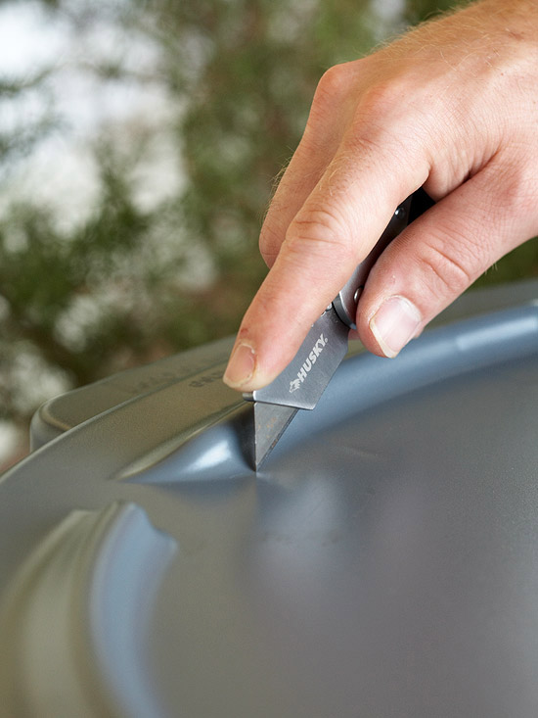
Step 5: Make entry and exit holes
Carefully cut a hole in the lid of your rain barrel. This hole should sit under your home's downspout so the water runs right into the barrel. Cut the hole so it's large enough to accommodate the water flow from the downspout.
You'll also want to drill a hole or two near the very top of your rain barrel. This hole will allow water to overflow.
Here's a hint: You can run a short length of hose or PVC pipe, from the overflow hole to another rain barrel to connect them. That way if your rain barrel fills, the excess water will run into the next one and you don't lose overflow water

Slide 8
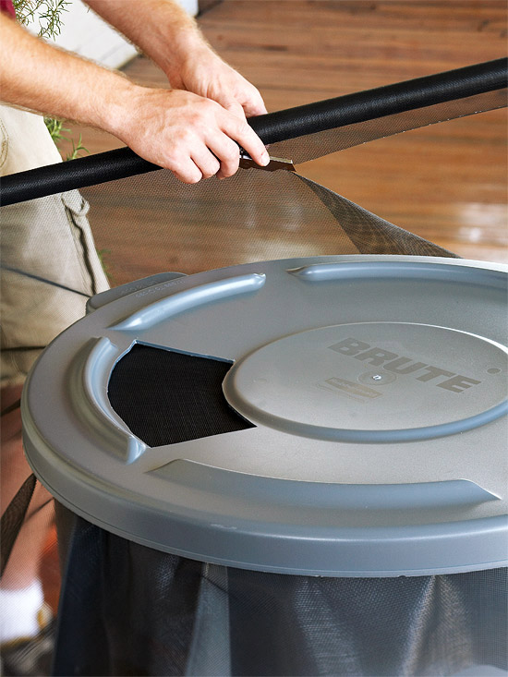
Step 6: Seal the top
Cut a piece of landscaping fabric to sit over the top, then put the lid over the top of it to secure it. This will create a barrier that prevents mosquitoes and other pests from getting in your rain barrel water.

Slide 9
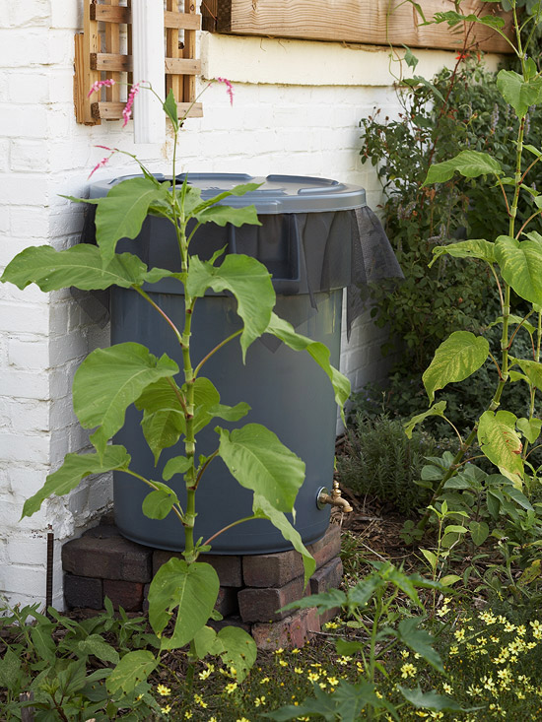
Step 7: Place your rain barrel
Now that the hard work is done, all you have to do is get your rain water barrel in place. Position it directly underneath your downspout in a spot that's most convenient for you to use it. Then just wait for it to rain so you can enjoy the water -- and money -- savings.
Here's a hint: Set your rain barrel up on a platform to help give more pressure if you connect it to a hose. It also makes it easier to fill up watering cans.

